Slide 1
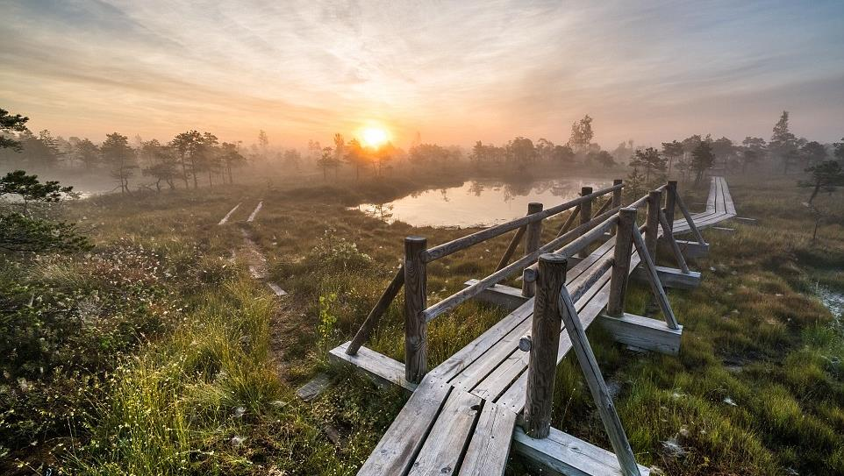

LATVIA
ERASMUS + PROJECT “DE.CO.D.E.”
2018-1-LV01-KA229-046985_1

Slide 2
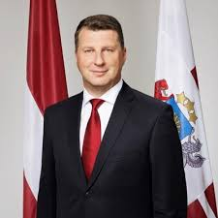
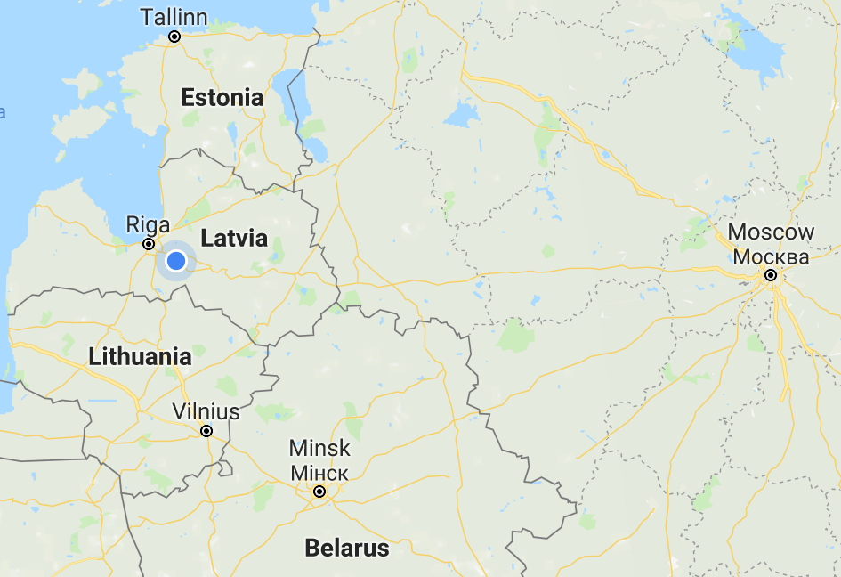

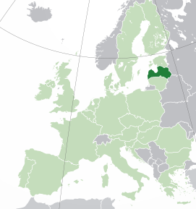
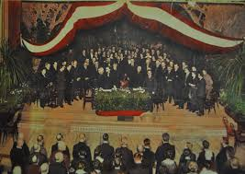
Basic information
Republic of Latvia
Declared – 18.11.1918
Capital – Riga
President – Raimonds Vējonis
Currency – Euro
Bordering countries – Lithuania, Belarus, Russia, Estonia

Slide 3
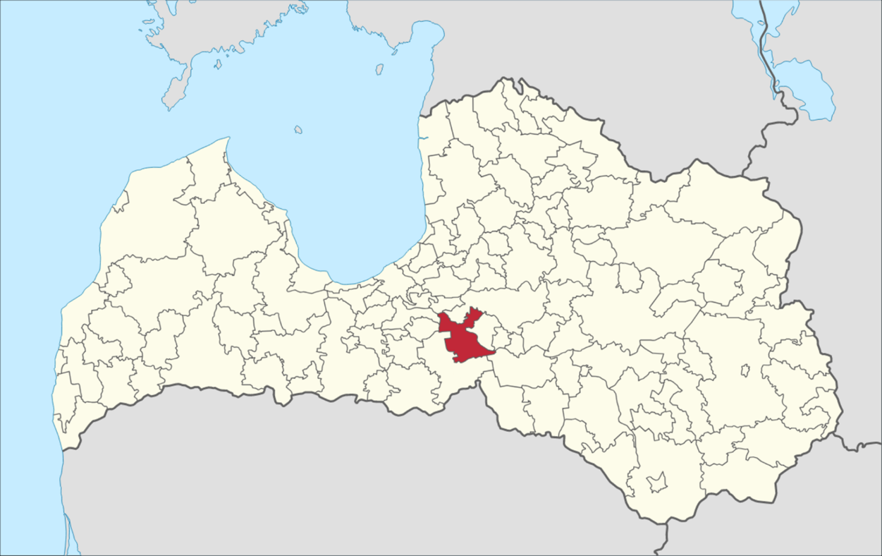
Our city and its district - Ķegums

Slide 4

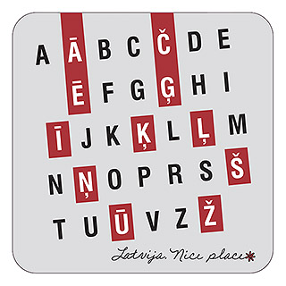
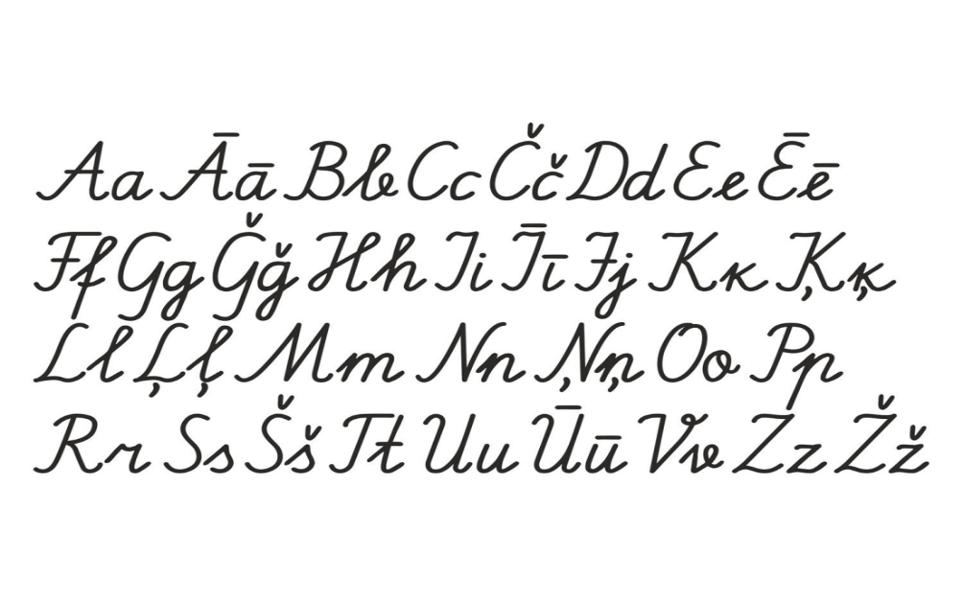
Language

Slide 5

Phrases
Basic phrases:
Hello! – Sveiki!
My name is... – Mani sauc...
How are you? – Kā tev iet?
Thank you! – Paldies!
I’m sorry - Piedod
Bye! - Atā!
Just for fun:
Narrow track railway – Šaursliežu dzelzceļš
Bundle of small branches – Žagaru saišķis

Slide 6
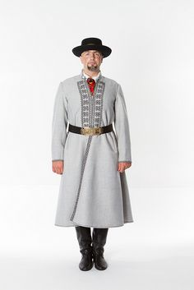
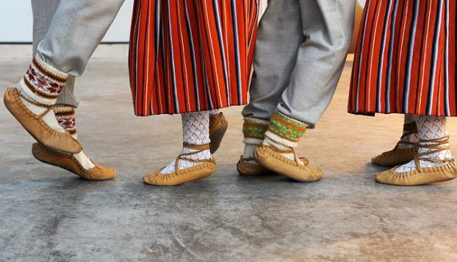
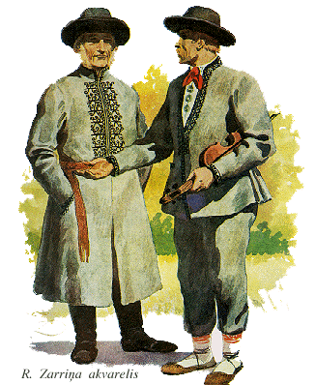
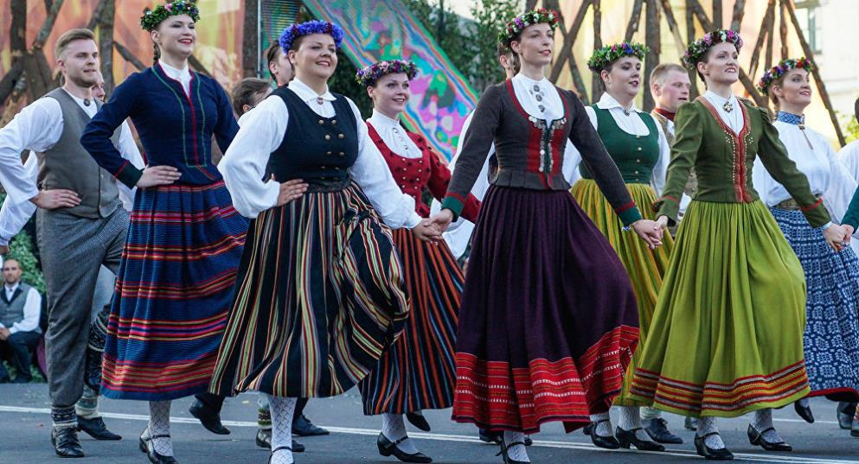
National costume

Slide 7
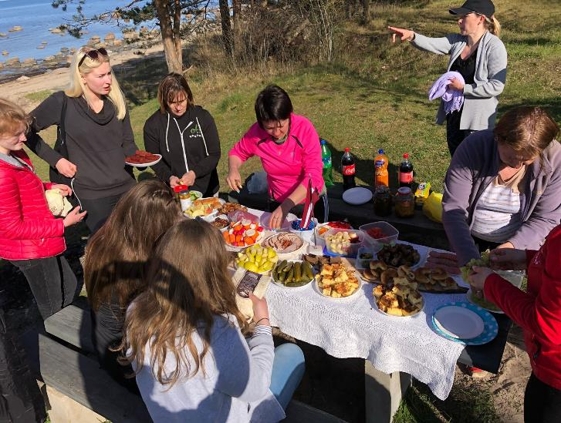
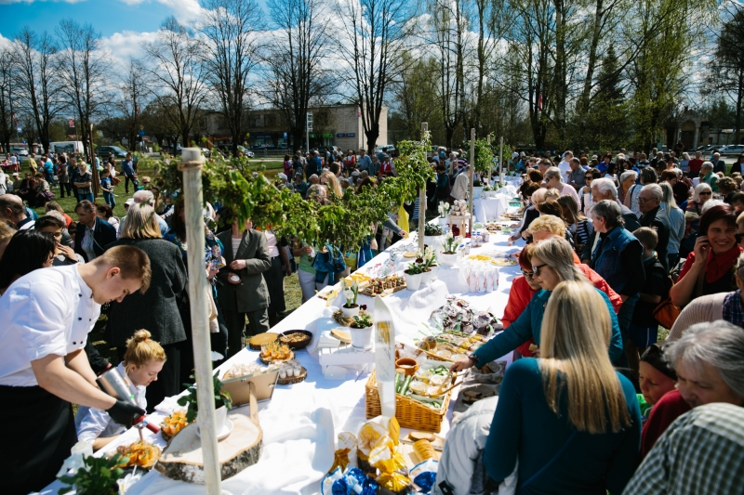
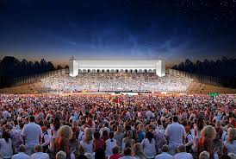
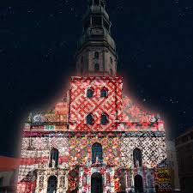
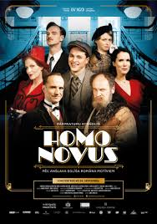
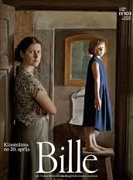
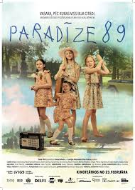
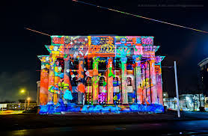
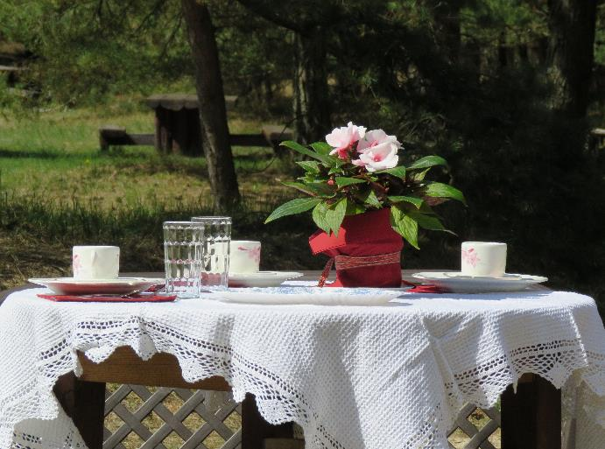
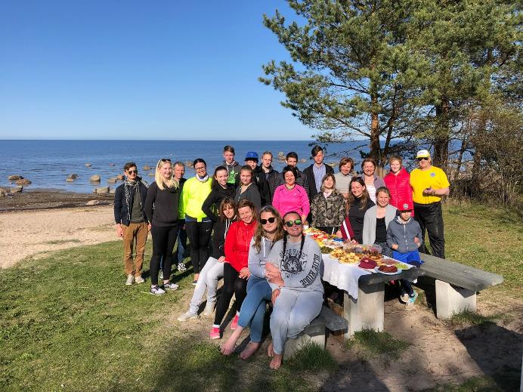
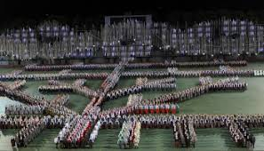

Centenary celebration highlights 2018
White tablecloth day
Nationwide Song and Dance festival
Staro Rīga, festival of light
Latvian films for Latvia’s centenary
The Latvian school bag

Slide 8
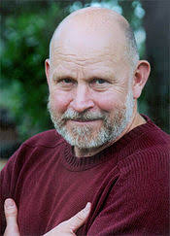
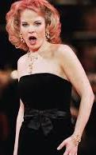
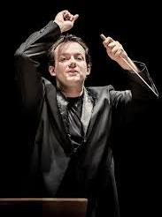
Famous Latvians
Grammy-nominated composer - Pēteris Vasks
Opera singer - Elīna Garanča
Most famous conductor - Andris Nelsons

Slide 9
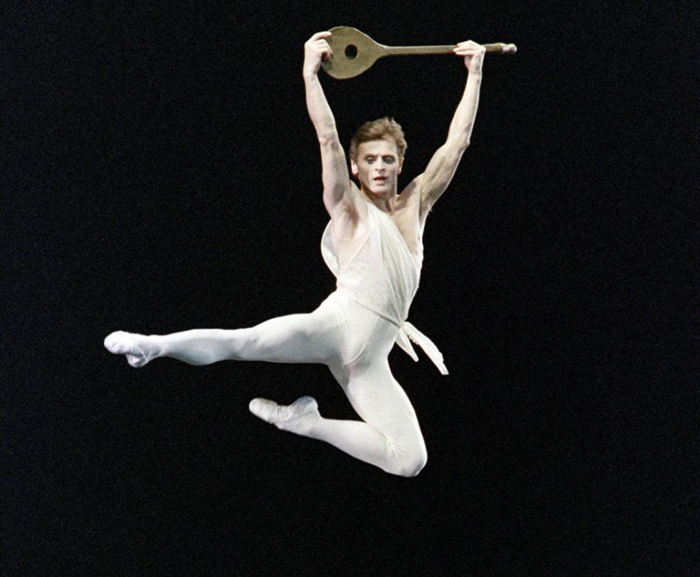
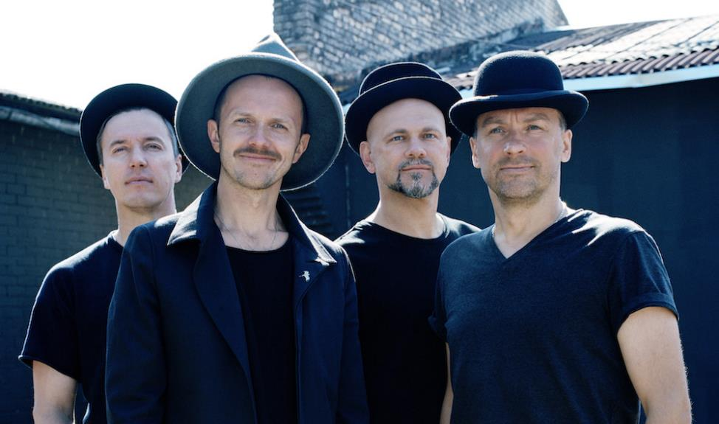
Dance star - Mikhail Baryshnikov
Biggest boy band - Prāta Vētra (Brain storm)

Slide 10
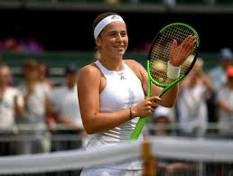
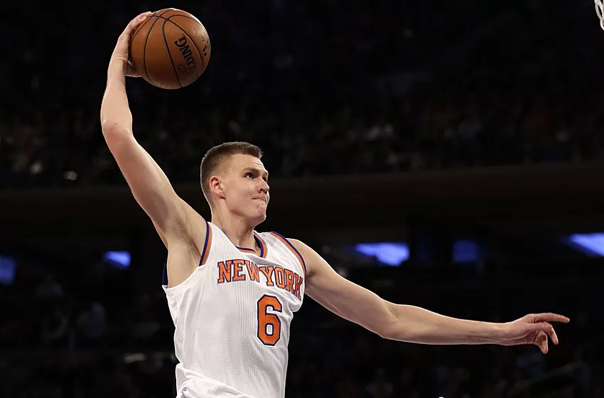
Champion after champion - Aļona Ostapenko
Basketball fame – Kristaps Porziņģis

Slide 11
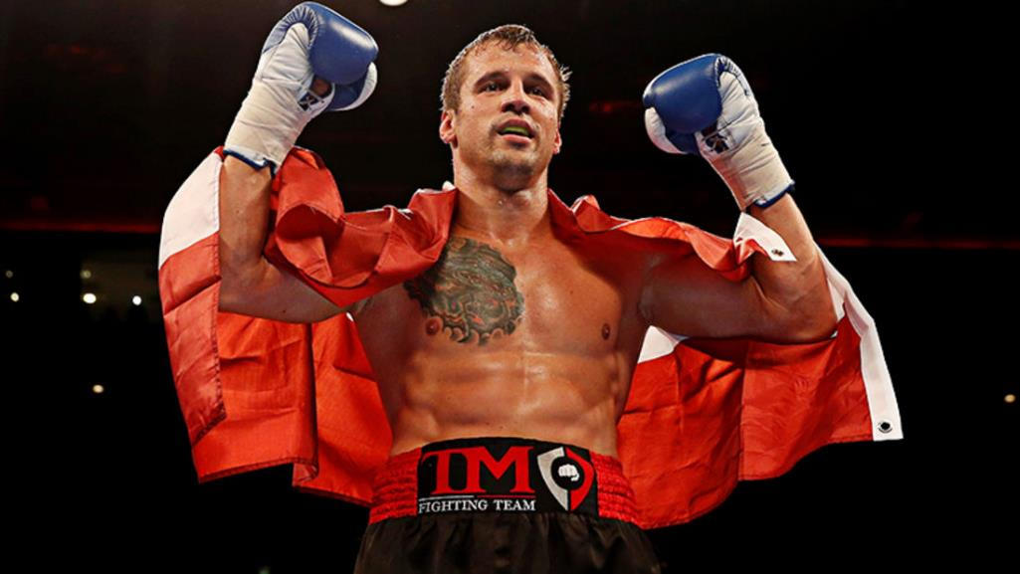
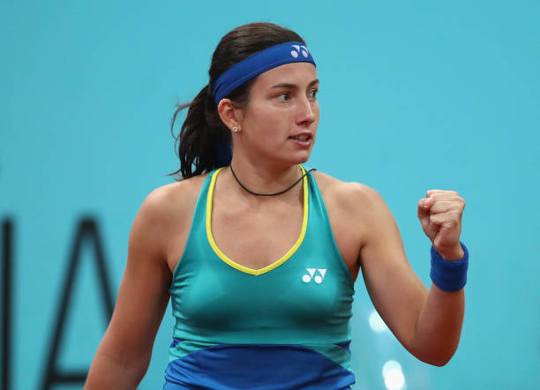
Winner of a boxing world title -Mairis Briedis
Tennis star - Anastasija Sevastova

Slide 12
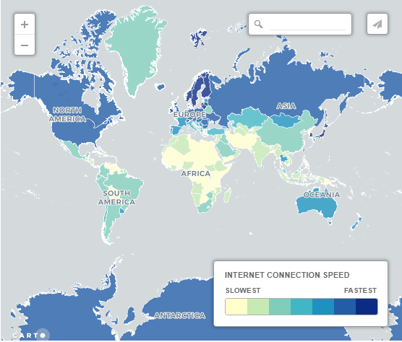
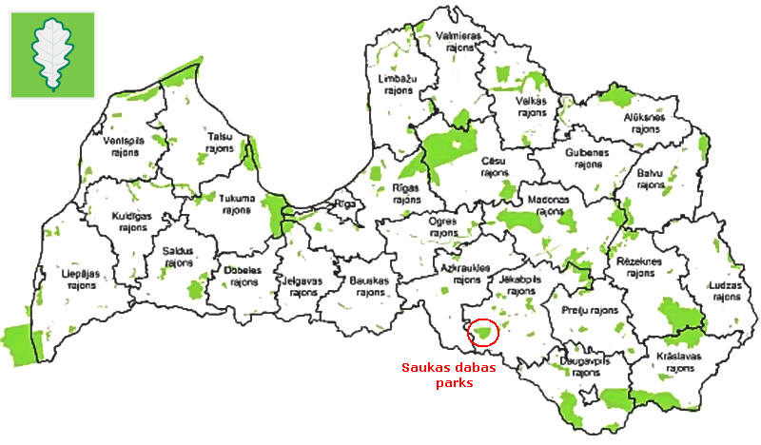
Amazing things you probably didn't know about Latvia
One of the fastest internet speeds in the world
Around 20% of Latvia’s territory is protected.

Slide 13
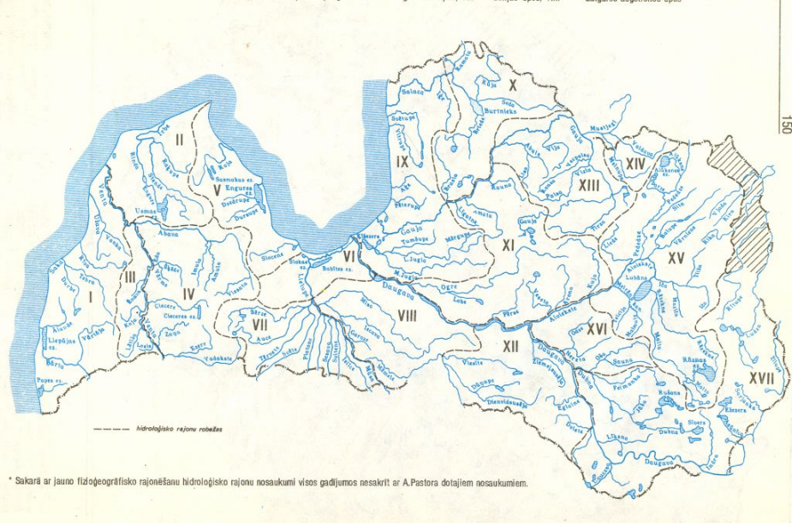
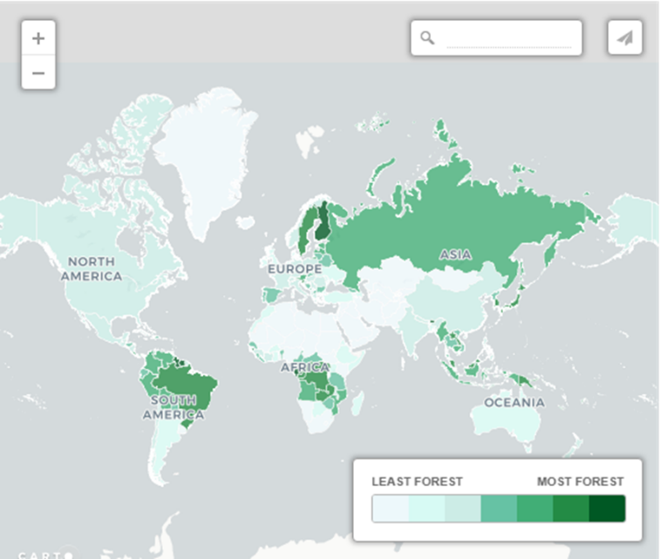
Latvia has 12,000 rivers and 3,000 small lakes
Around 54% of Latvia is forest, making it one of Europe’s greenest countries

Slide 14

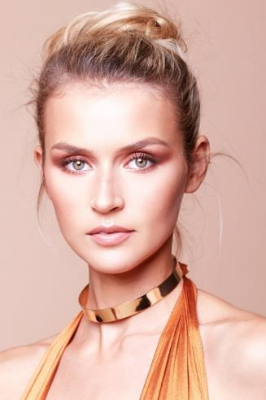


Latvia produces more female models per capital than almost any country in the world.
Latvia’s current flag design has been in use since 1280. Only Denmark’s has been around longer.

Slide 15
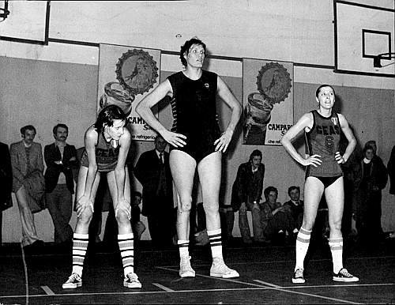
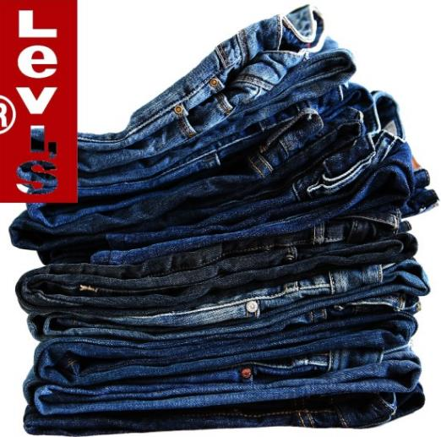
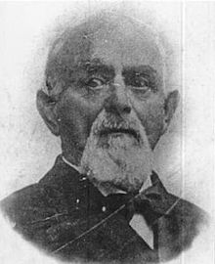
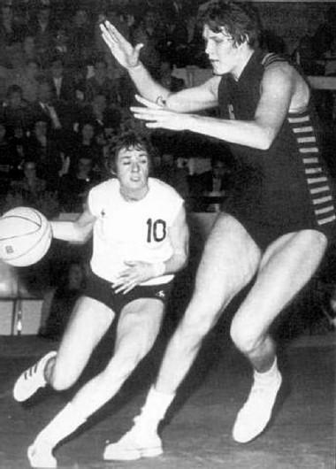
Uļjana Semjonova – the first non-American woman to be inducted into the NBA Hall of Fame.
Jacob W. Davis (born in Riga) – made the first template for modern denim jeans.

Slide 16
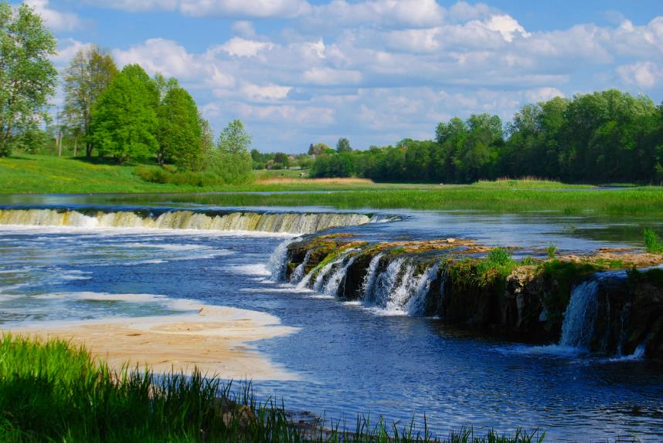
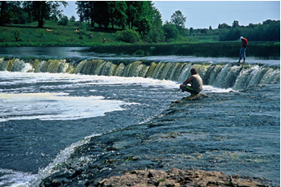
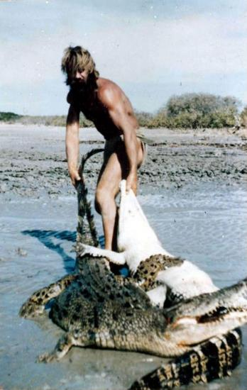
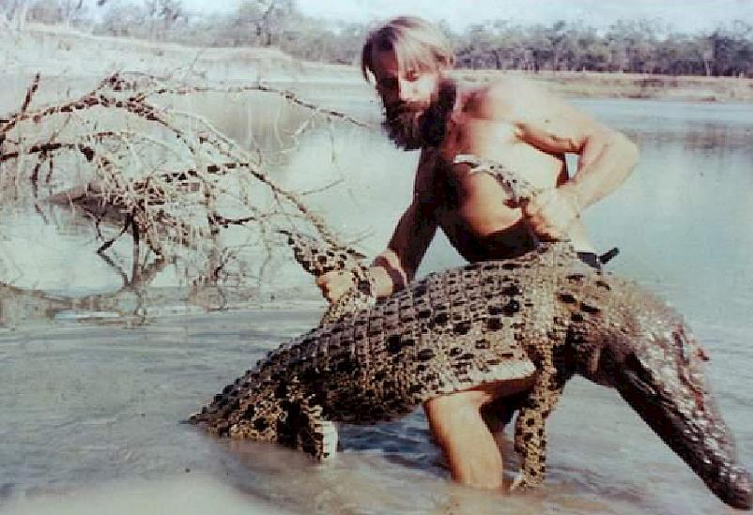
Venta Rapid in Kuldīga is the widest waterfall in Europe.
According to some sources, the inspiration for Crocodile Dundee may have been Arvīds Blūmentāls (or Crocodile Harry).

Slide 17
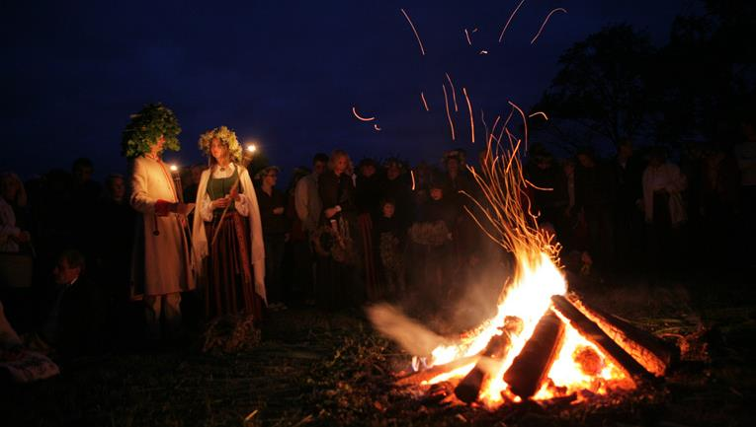
Celebrations

Slide 18
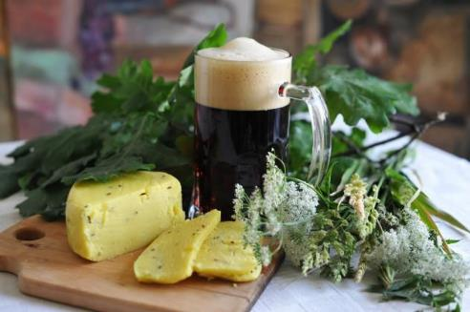
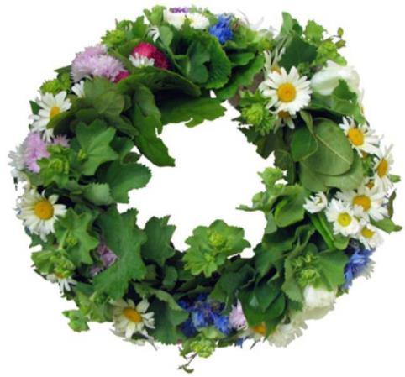
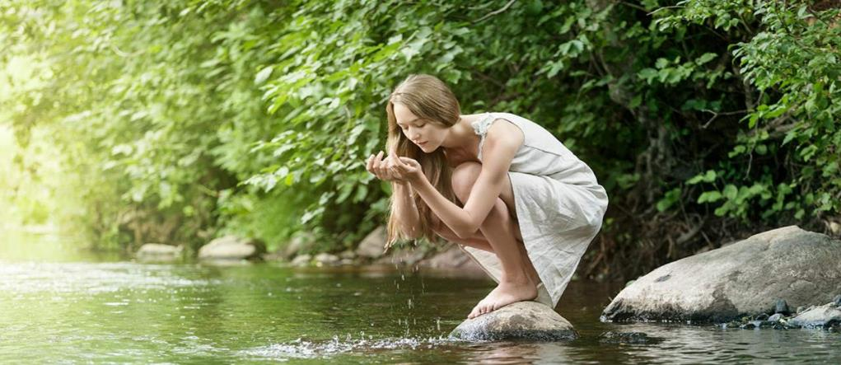
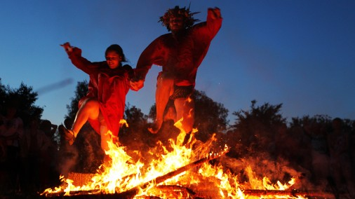
Jāņi (Summer solstice)
Night from June 23 to June 24.
Wild flowers picked on summer solstice are believed to have healing powers.
Homes are decorated and women weave wildflower crowns.
Many traditions, including leaping over the bonfire.
Sleeping is only allowed after sunrise.

Slide 19






Ziemas saulgrieži (Winter solstice)
"Ziemassvētki" or Christmas in Latvia is a mix of ethnic, religious and modern traditions.
Rīga is recognised as the birthplace of the first Christmas tree in 1510 by some accounts.
Traditional dishes are served at Christmas (Christmas roast and grey peas, bacon rolls, gingerbread cookies)

Slide 20


Name days
Marked in the calendar.
Each day includes up to four names.
May 22 – day to celebrate the names not included in it.
Customary that anyone can join a name-day party without an invitation.

Slide 21

Our school

Slide 22

There are 301 students at our school

Slide 23

Educational system
Start school at the age of 7.
Grading scale – from 1(the lowest) to 10.
In high school(10th to 12th grade), an average of 17 different subjects in total.
Length of each class – 40 minutes.
We learn English and Russian as our foreign languages.

Slide 24



Elementary school (1.-4.class)
After school activities
Music | Creative | Science | Sport
Choir Folk dance | Pottery Theater Wood working | Math Environmental chemistry Chess | Athletics Orientation sport Gymnastics for body development

Slide 25



Middle school(5.-9.class) + Secondary school(10.-12.class)
Music | Creative | Sport
Choir Vocally instrumental ensemble | Arts Theater | Athletics Eastern martial arts Orientation sport Boxing

Slide 26




School events/activities:

Slide 27







Slide 28






Slide 29




Riddle me
Riddle me
What can’t you step over?
Two sisters- one is white and one is green, when one comes the others goes.
A golden ball rolling over the hill.
One is walking, but you see two.
A small, small man with a needle coat.
Both ends are white and the middle is green, what is it?

Slide 30
THANK YOU FOR LISTENING!

