Slide 1

The Continuing Professional Development of Teachers (CPD)
Erasmus+ project “DE.CO.D.E.”
2018-1-LV01-KA229-046985_1
Teachers’ workshop
Ilze Krastina, Latvia

Slide 2
What is CPD?
Continuing professional development (CPD) is a planned, continuous and lifelong process whereby teachers try to develop their personal and professional qualities, and to improve their knowledge, skills and practice, leading to their empowerment, the improvement of their agency and the development of their organisation and their pupils.
(Padwad, Amol; Dixit, Krishna (2011)

Slide 3
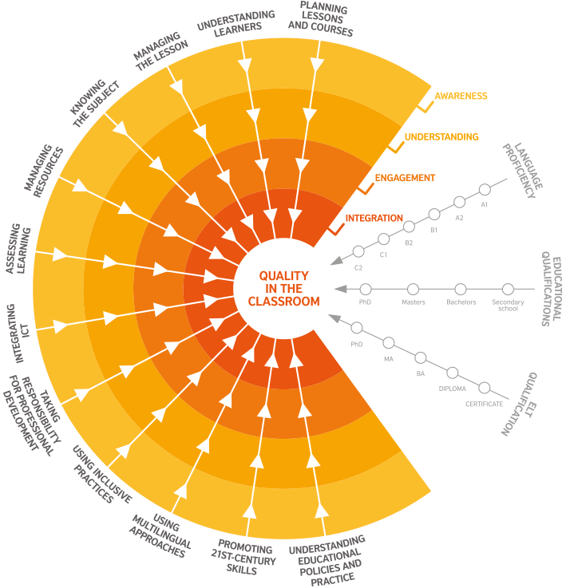
Notes:
12 professional practices

Slide 4
Promoting 21st century skills
Developing an awareness of and proficiency in:
critical thinking and problem solving
collaboration and communication
creativity and imagination
citizenship
digital literacy
student leadership and personal development.

Slide 5
Using inclusive practices
Recognising and valuing diversity among my learners in relation to areas which include:
language background
cognitive ability
academic ability
physical ability
social background
behavioural differences
disability
race and ethnicity
religion and belief.

Slide 6
Ways and Forms of CPD
There is a considerable amount of Continuing Professional Development (CPD) provision for teachers, delivered in many forms and covering most subjects and many aspects of school life.
  F2F Seminars/ courses;
  Webinars;
  On-line courses.

Slide 7

School Education Gateway
http://www.schooleducationgateway.eu
Online courses
Webinars
On-site courses
Lesson plans

Slide 8
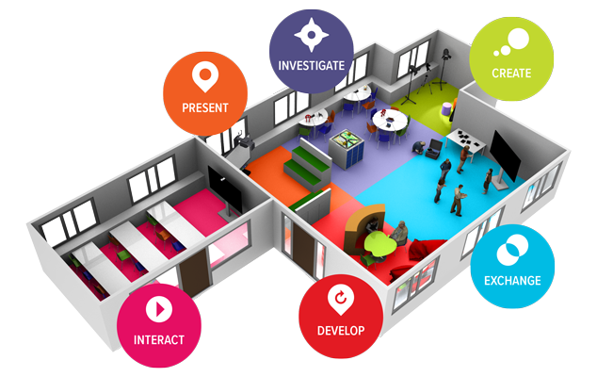
Future Classroom Lab
Based in Brussels
http://fcl.eun.org/

Slide 9
CPD at schools
CPD is not just about formal courses. Some of the most valuable professional development occurs in activities undertaken with colleagues in the working environment.
  Self-evaluation and reflection
  Curricular planning
  Peer support e.g. coaching or mentoring
  Classroom visits/observation
  Work shadowing
  Co-operative or team teaching
  Leading or participating in a working or task group
  Planning learning which is inter-disciplinary or cross-sectoral.

Slide 10
The demand of CPD
36 hours in 3 years (Latvia)

Slide 11
