Slide 1


LATVIA’S VIRTUES AND FLAWS
ERASMUS + PROJECT “DE.CO.D.E.”
2018-1-LV01-KA229-046985_1

Slide 2
Culture

Slide 3
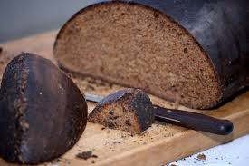
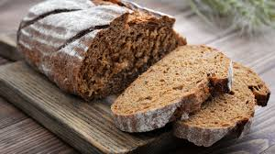
In Latvian cuisine bread has a special place, and every bowl of soup isn’t imaginable without a slice of bread on the side.
Rye-bread
Though, we eat bread not only during main course meals.

Slide 4
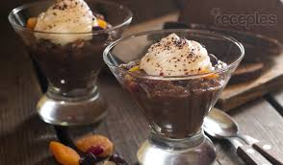
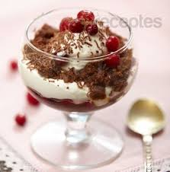
Latvians are witty and have decided on how to use bread on a different level, we’ve also made it as a part of desserts.
There’s no surprise that the best known dessert from Latvia is rye-bread soup which gets decorated with a bit whipped cream on top.

Slide 5
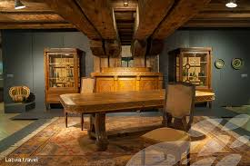
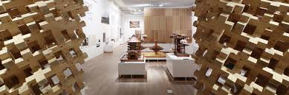
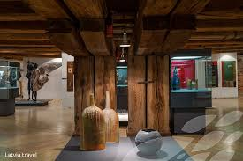
Wooden architecture, broad museum halls, and World level performances from artists- this is just a part of our culture’s offer in which anyone can find something that speaks out to them.

Slide 6
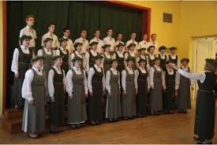
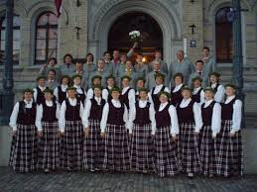
Latvia’s cultural treasure- amazing and strong voices. Our choirs have allowed us to shine and get known on our planet.
Our strong voices have also shown their best in operas all around the world. A lot of people consider it a mystery that there are so many well-known artists, who are from our small country.

Slide 7
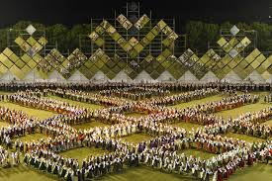
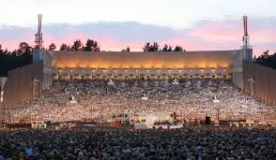
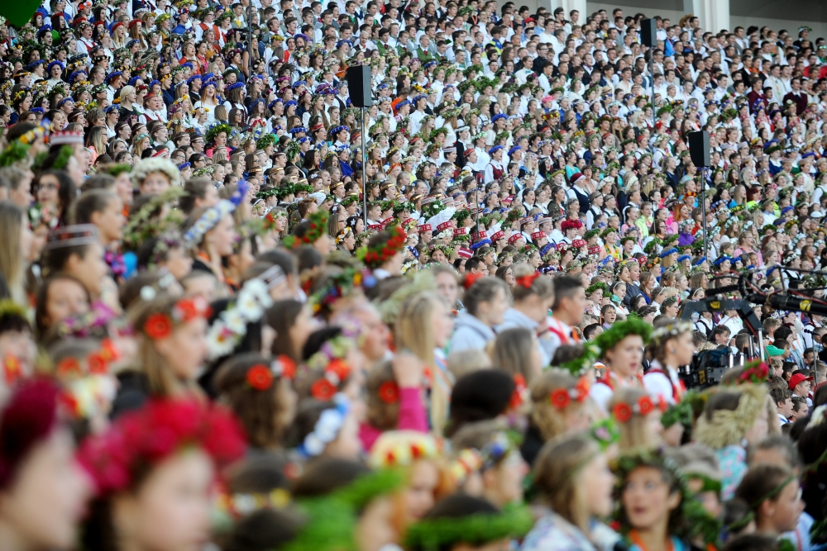
Every 5 years around 40 000 people meet for the Latvian Song and Dance Festival, which during the years has become a part of our Latvian identity.

Slide 8
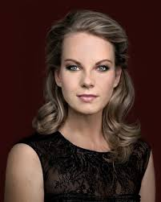
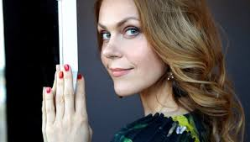
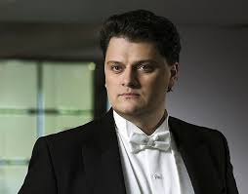
Elīna Garanča, Kristīne Opolais and Aleksandrs Anteņenko are just a few of the excellent Latvian opera singers who make our country’s name popular in the world.
Kristīne Opolais
Elīna Garanča
Aleksandrs Antoņenko

Slide 9
Musicians

Slide 10
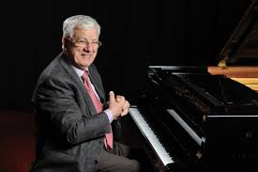
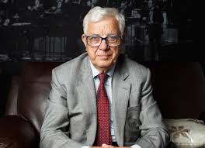
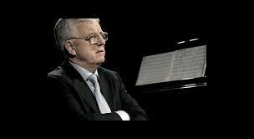
Raimonds Pauls is a Latvian music composer, pianist and a politician. He’s one of the most famous Latvian composers who has written music for musicals,films and even three ballets. His most famous works are ‘’Vella kalpi’’,’’A Limousine The Colour Of A Midsummer’s Eve’’.

Slide 11
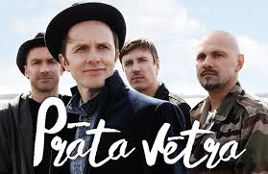
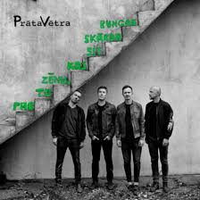
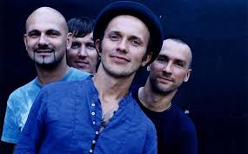
Prāta Vētra is possibly the most loved Latvian band. Its five members- Kaspars Roga, Renārs Kaupers, Māris Mihelsons, Jānis Jubalts and Gundars Mauševics started their group’s work in Jelgava during 1989. Prāta Vētra’s music is enjoyed by many people of different age groups.

Slide 12
Athletes

Slide 13
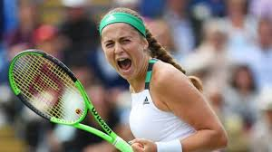
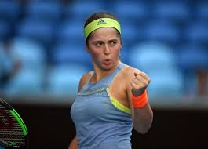
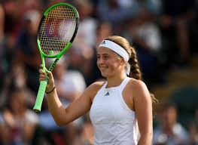
Alona Ostapenko is a Latvian tennis player. She is the winner of French Open Tournament in 2017 and the same year she was the quarterfinal player of Winbledon Tournament.

Slide 14
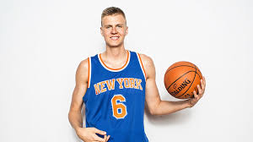
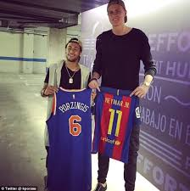
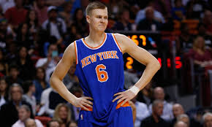
Kristaps Porziņģis is a Latvian basketball player. His position is a power forward. Currently he represents the NBA club Dallas’ ‘’Mavericks’’

Slide 15
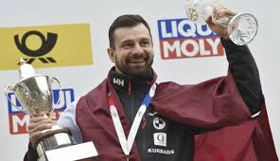
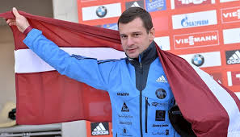
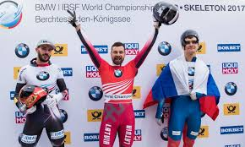
Martins Dukurs is a Latvian skeleton racer. He’s gotten a silver medel twice during the Winter Olympics, also an eight-fold world cup winner as well as a five-fold World and ten-fold European champion.

Slide 16
Latvia’s celebrations

Slide 17
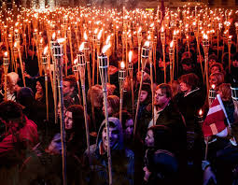
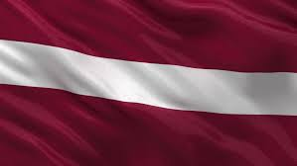
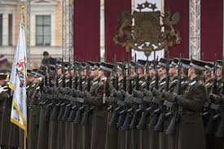
18th of November- The proclamation day of Latvia.

Slide 18
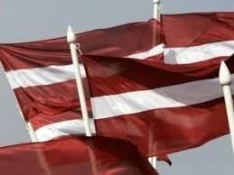
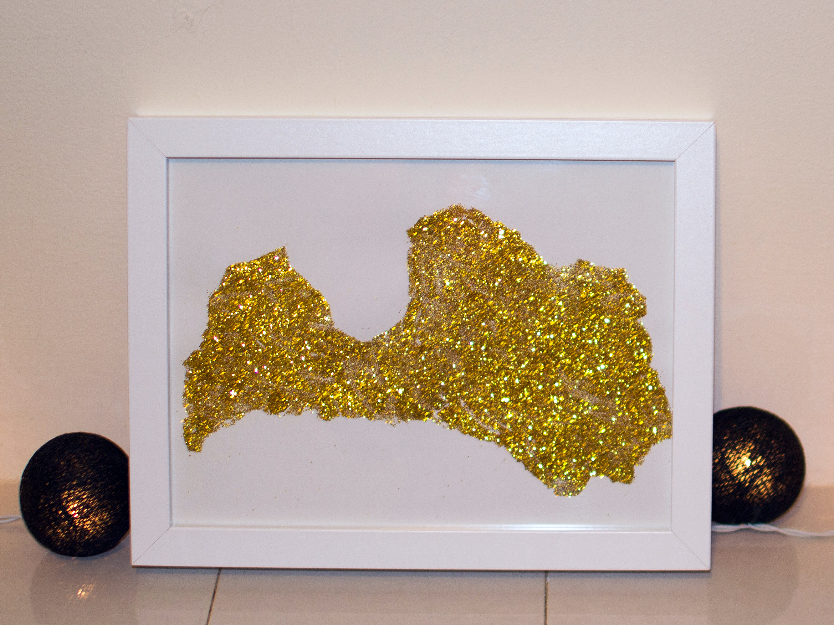
4th of May- declaration of the independent Republic.

Slide 19
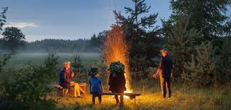
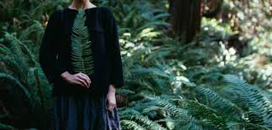
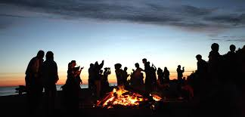
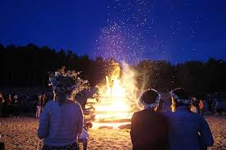
23rd-24th of June- Summer Solstice

Slide 20
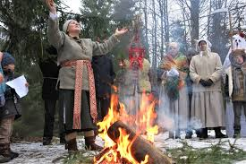
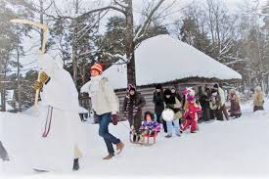
25th-26th of December- Winter Solstice.

Slide 21
Even though Latvia is known to be a strong country it has experienced horrible events and it has many painful memories from the past.

Slide 22
World War I (1914-1918)

Slide 23
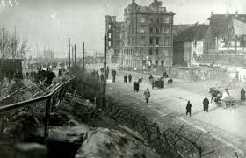
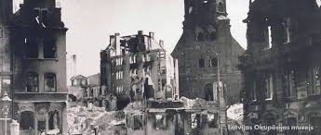
The result of World War I:
*Russian and German empires collapse.
*Latvia gets a good opportunity to create the independent Republic of Latvia.

Slide 24
World War II (1939-1945)

Slide 25
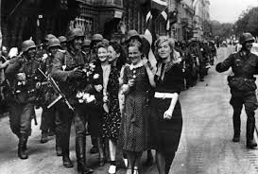
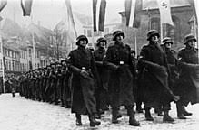
The result of World War II:
*Latvia becomes the part of the Soviet Union...

Slide 26
Deportations

Slide 27
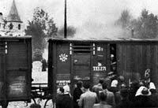
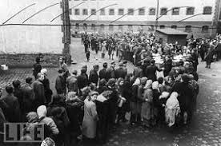
Most of the people who were deported had their names written in the list of the Soviet regime.
1941 is the horrible year of June deportations. Around 15 thousand Latvians were sent to Siberia where winters use to be really harsh.

Slide 28
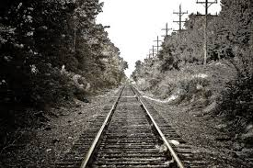
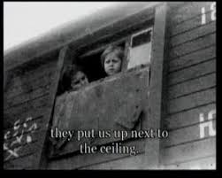
A few years later in 1949 Latvia experienced another mass deportation.
This time more than 90 thousand Baltic country citizens were deported once again to Siberia.
This was a shock to Latvian people and many Latvian farms joined kalkhozes.

Slide 29
Thank you for your attention, and we hope you got to learn something new about Latvia.

