Slide 1


Professionalism and personal brand
Kegums commercial secondary school
(Sabine driviniece, rihards piesis, maksims jevdokimovs)
ERASMUS + PROJECT “DE.CO.D.E.”
2018-1-LV01-KA229-046985_1

Slide 2

Professionalism in a Digital Age - what is it?
Digital professionalism – The competence or skill expected of a professional when engaged in social and digital communication.

Slide 3

What is "Netiquette"?
Netiquette is the correct and acceptable way of using the internet.
Netiquette is a short form of network etiquette or Internet etiquette.

Slide 4

Netiquette dos
Respect other people's privacy
Verify facts before reposting
Check messages and respond promptly

Slide 5

Netiquette Don'ts
Name-call or express offensive opinions
Post private or embarrassing images or comments
Exclude people or talk behind their backs

Slide 6
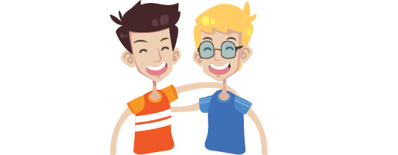
Basic rules of netiquette
Real People Take Priority

Slide 7
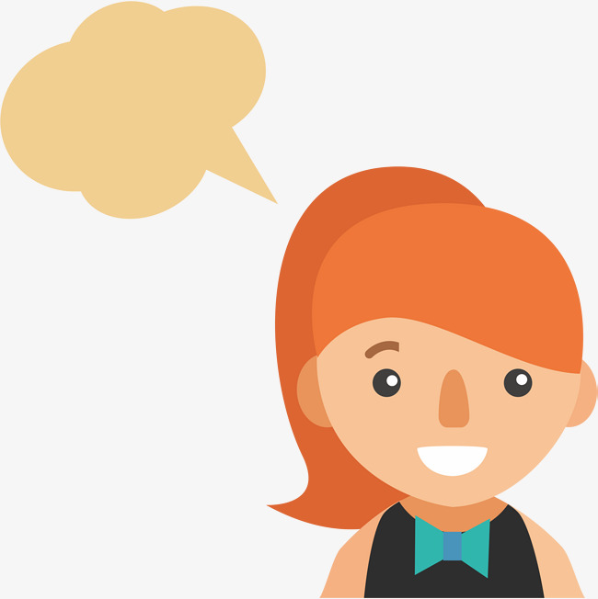
If You Wouldn't Say it to Someone's Face, Don't Say it Online

Slide 8

If you wouldn't show it in public, don't post it online

Slide 9

Respect People's Privacy

Slide 10
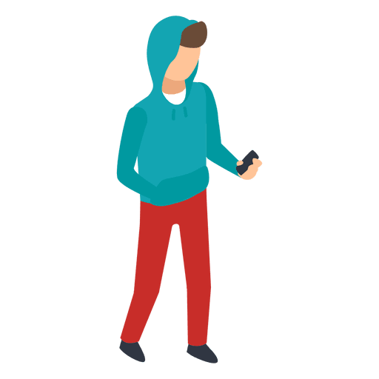

Don't Repost Without Checking the Facts

Slide 11

Update Online Information That People Depend Upon

Slide 12

A digital tattoo – what is it?
A digital tattoo more or less is the same as a "digital footprint".
It’s nearly impossible to erase something from the Internet, so the word ‘tattoo’ is more accurate to describe the mark that we leave when we use the Internet.

Slide 13
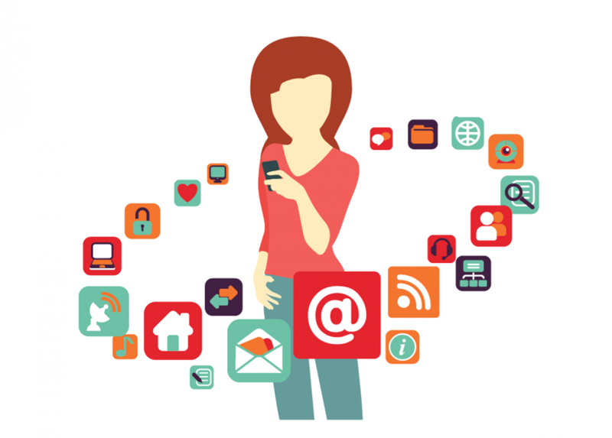
What forms my digital tattoo?
The most of our digital tattoo is created by what we share on social media, however, much of the information stored about us online is not chosen or consented to.

Slide 14
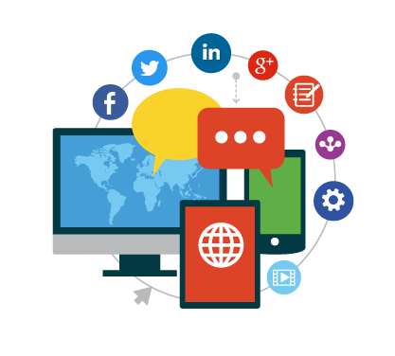
What's the issue?
When images and videos are posted online, they can end up anywhere in the world and be re-used in ways that we never intended—even years later.

Slide 15
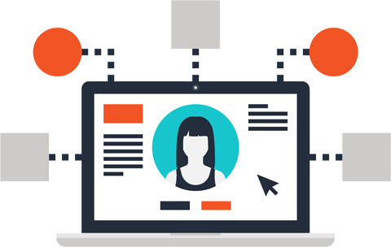
Why does it matter?
People will form opinions of you by your social media profiles.
Digital material is no longer under your control once it has been shared. Once stuff about you goes online there is no knowing where it will end up.

Slide 16
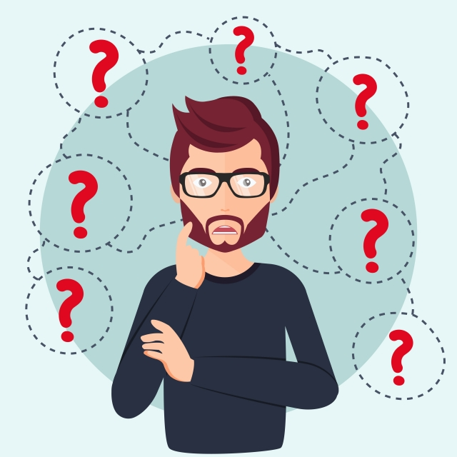
Before posting online, think twice and ask yourself:
What would this look like to your Grandparents?
What would this look like to your teachers?
What would this look like to your friends?
What if this post resurfaces in ten years time?

Slide 17
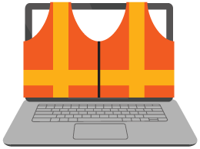
Internet safety

Slide 18
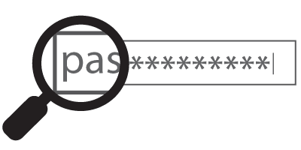
Use complex passwords

Slide 19
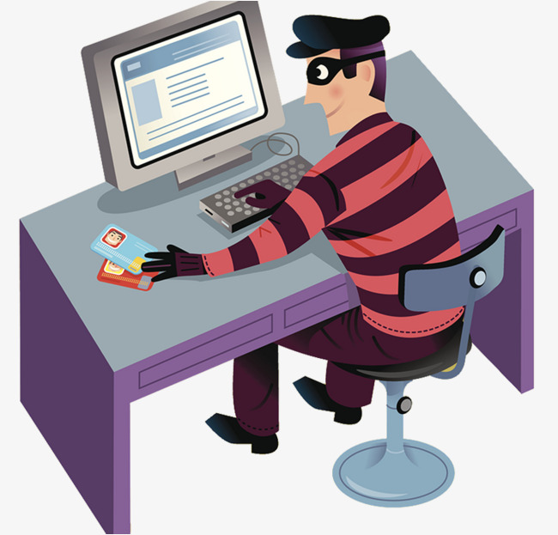
Be aware of scams and suspicious links

Slide 20
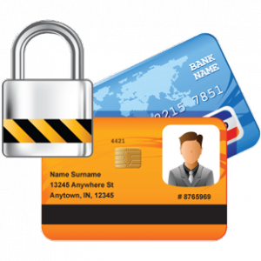
Don't share personal information or photos

Slide 21
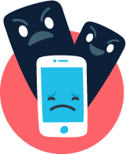
React to cyberbullying

Slide 22
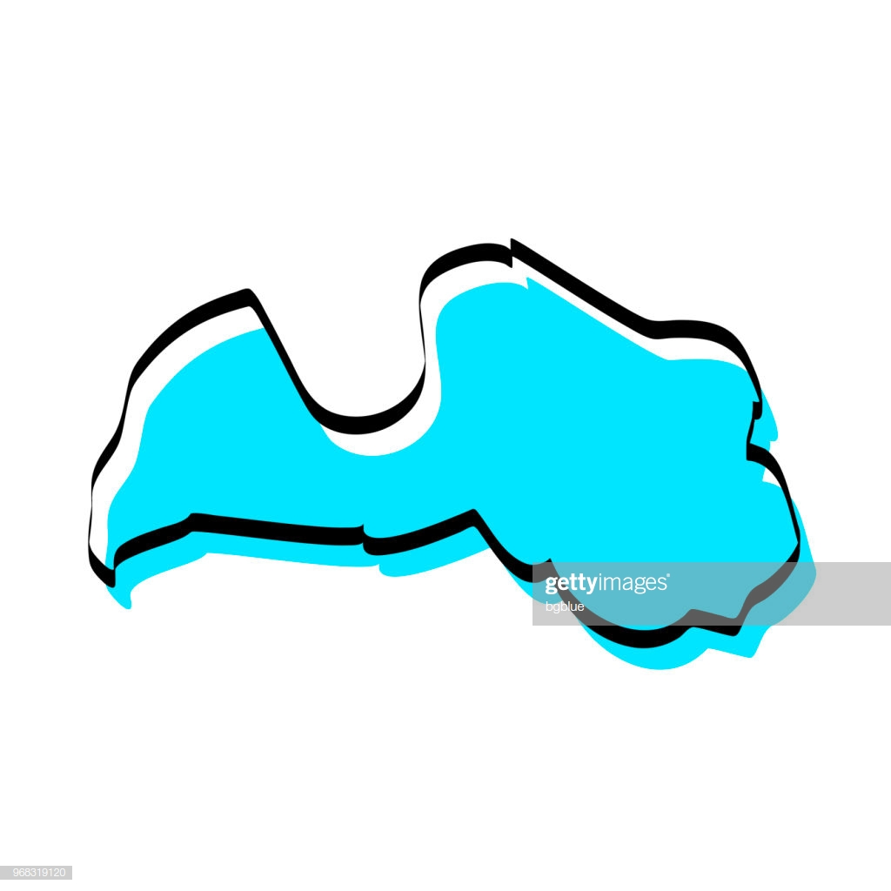

Internet safety in Latvia
We have a few internet safety sites, which help people understand internet safety basics and helps with Infringement on the Internet and provides online safety lessons.

Slide 23

Safer Internet Day
Every year, on the first Tuesday of February, the whole world celebrates Safer Internet Day
Latvia also participates in this event

Slide 24



Latvian Safer Internet Centre
Latvian Safer Internet Centre’s main tasks are – to raise awareness in society about the safer use of internet and provide an opportunity to report breaches on the Internet using www.drossinternets.lv website and provide professional consultations of psychologists via Helpline 116111.

Slide 25

Drossinternets.lv
Most popular internet safety website
Study materials and tests about safety on the internet;
Consultations and lessons for students.
Mobile application, where you can receive professional help if you're having problems on the internet.

Slide 26
Teenager behavior research
73% of teens in Latvia recognize that they behave differently on the internet and in real life.
53% of teens listen to unlicensed music
56% of teens watch unlicensed films
1/3 of teens play unlicensed games

Slide 27
73% of teens don't take action, when they see alarming content on the internet.
Every third teenager doesn't think about grammar and spelling.
Every fifth teen has texted a person, who was in the same room.
67% of teens recognize, that they use the internet during lessons, but not for
studying.

Slide 28
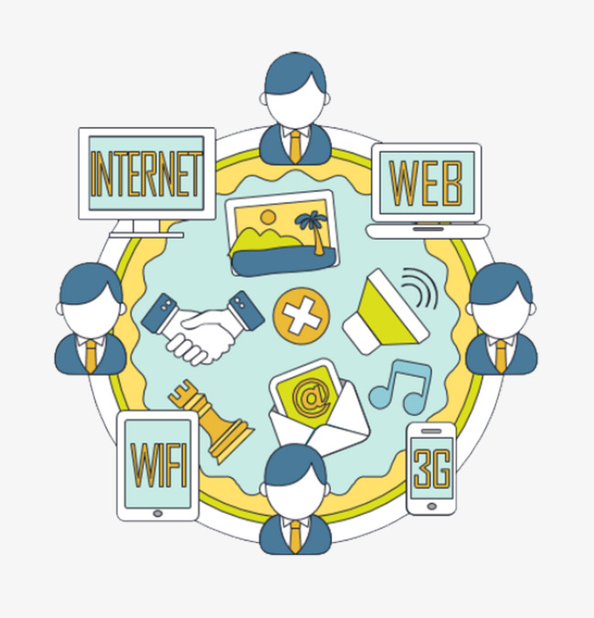
Statistics about Latvian children and adolescents' (9-16 years) internet habits
54% of teenagers trust the internet on finding information
40% of teenagers share untested information
57% of teenageers spend more than 3 hours a day on the internet.

Slide 29
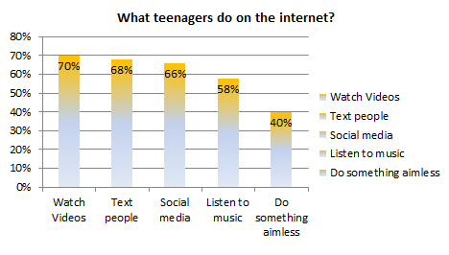
Top 5 things what Latvian teenagers do on the internet

Slide 30
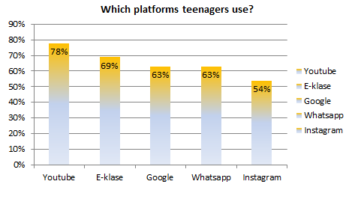
Top 5 platforms that Latvian teenagers use?

Slide 31

What does this mean?
Latvian teenagers are having trouble to tell the difference between true and false information on the internet
Children and teenagers in Latvia use the internet mostly for fun and not for school.
Most teenagers trust the information that they see on the internet and don't check facts before sharing.

Slide 32

What can we do to prevent these problems?
Teach teenagers to look at information from multiple sites and compare it
Have teachers give students more homework, so they don't spend all their time on games or videos.
Have teachers give students more online quizzes.

Slide 33
Thank you for your attention!

